Slide 1
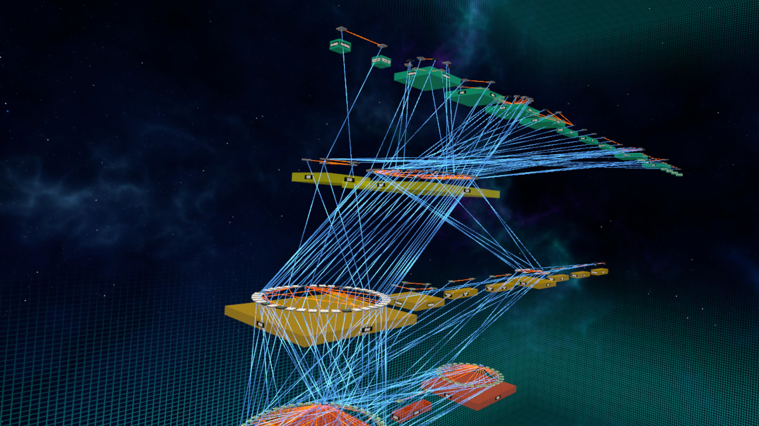
Photon
Demonstration

Slide 2
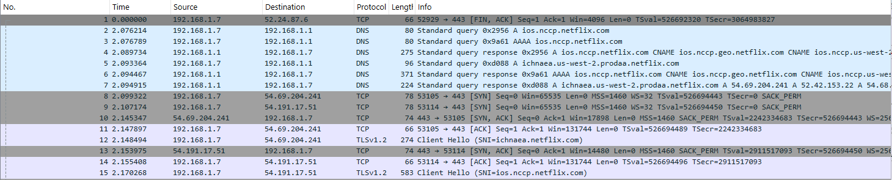
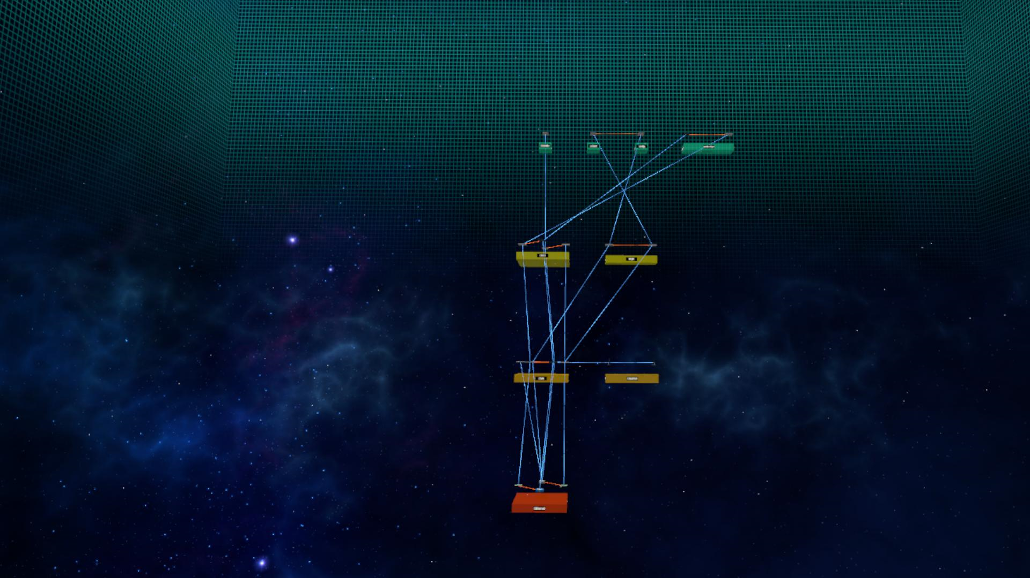
Photon Summary
Photon is a PC VR application for viewing 3D visualizations of network traffic.
Import PCAP Files
Includes multiplayer support.

Slide 3
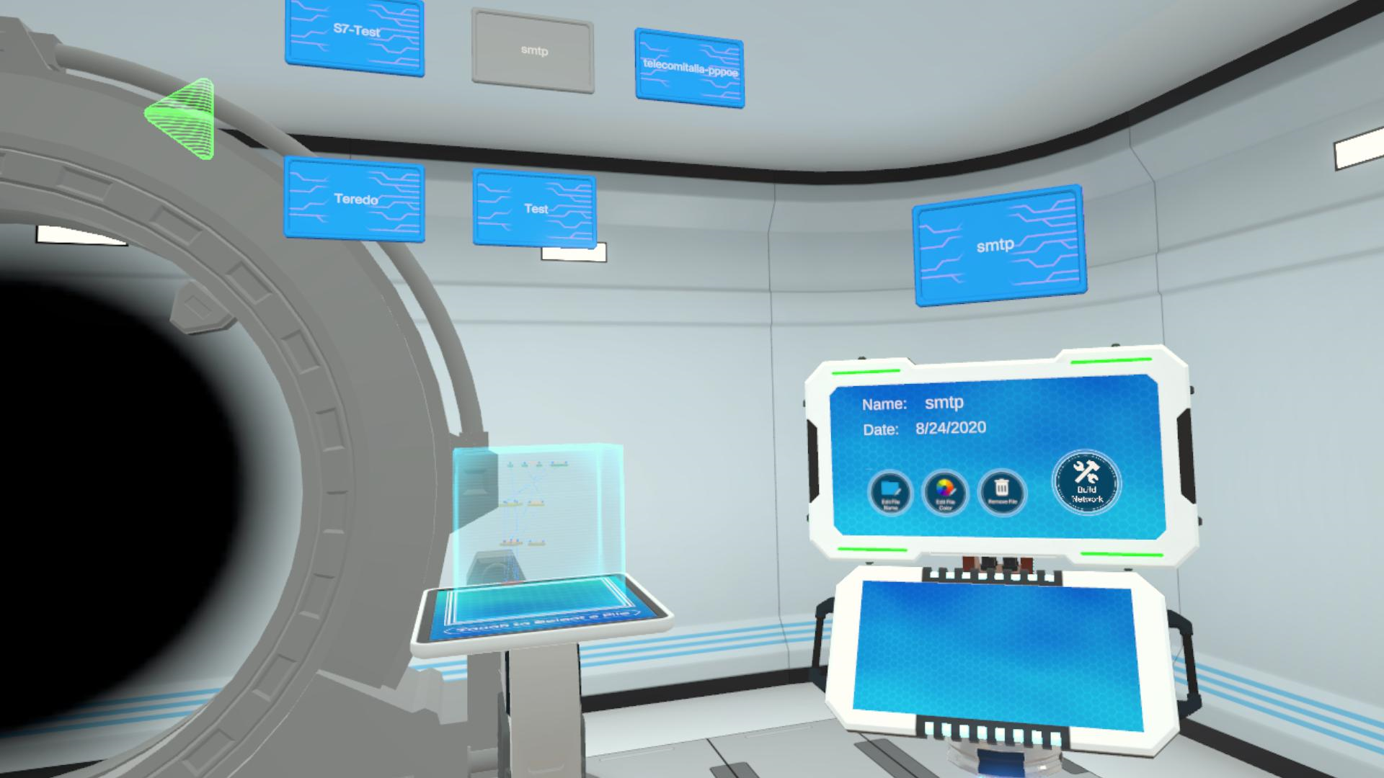
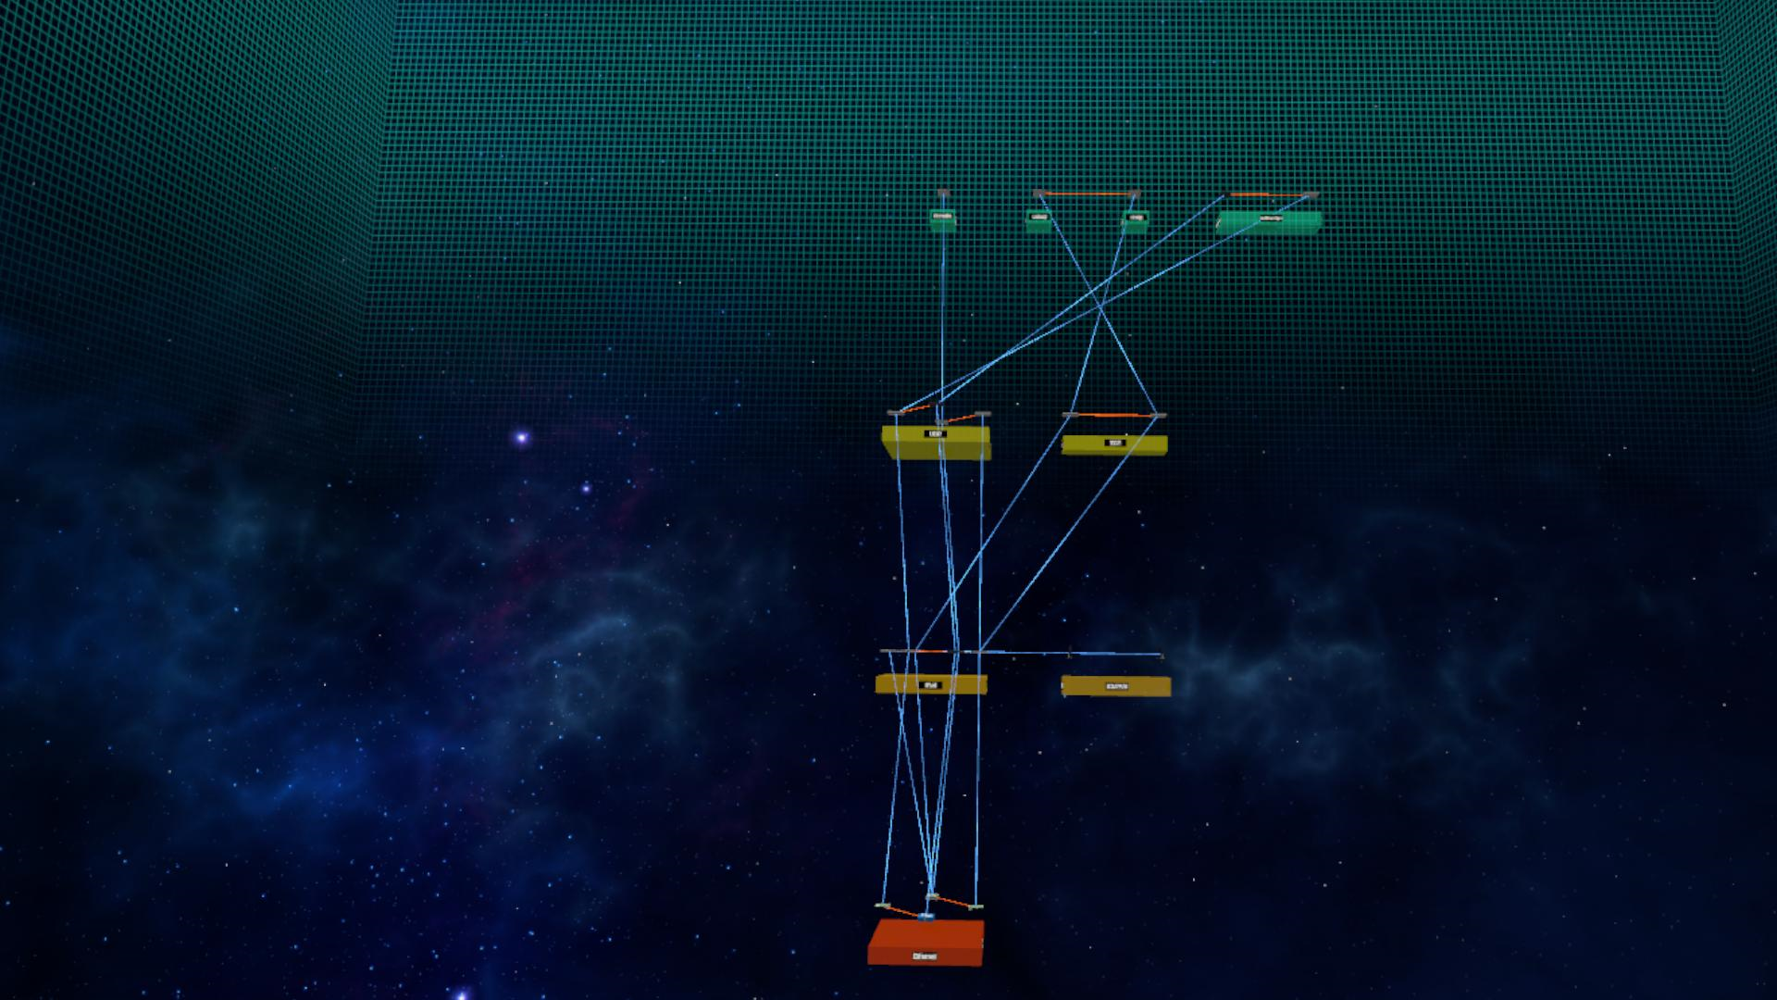
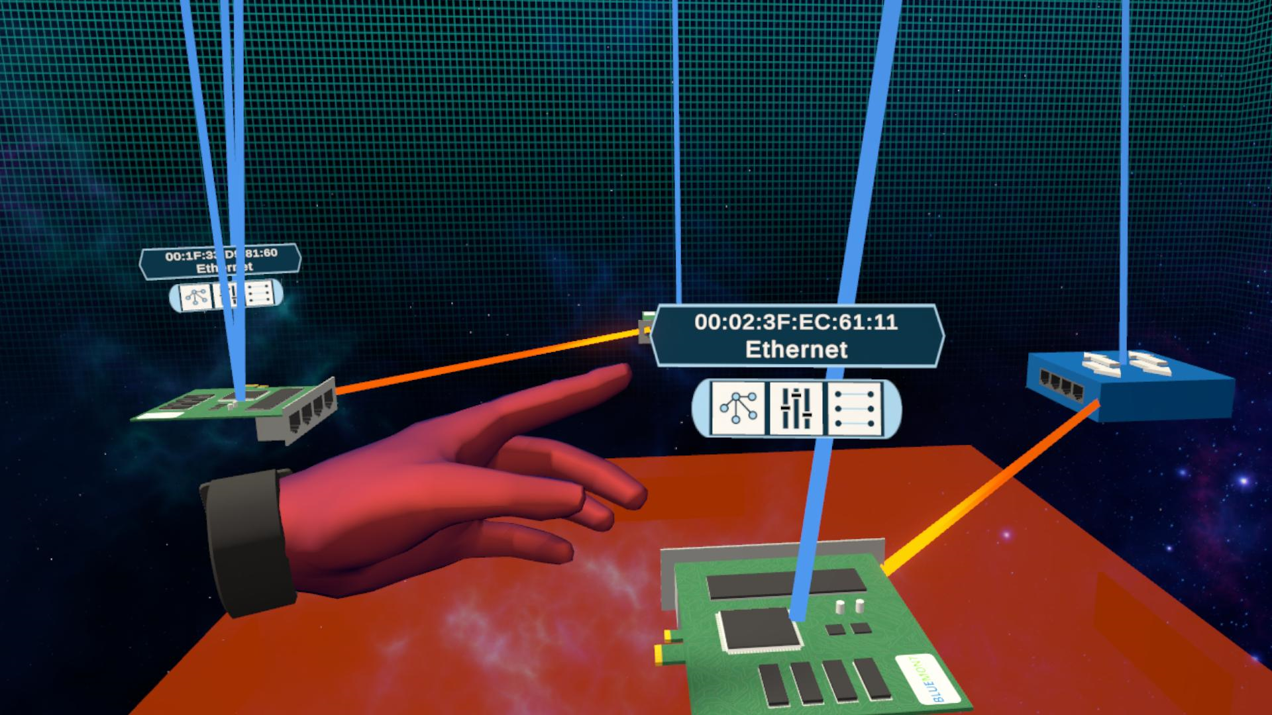
Workflow
Select Network File
Load Visualization
Filter & Examine
Use the file selector to browse & import a PCAP file
View the big picture summary of network activity
Inspect individual network devices at multiple protocol levels

Slide 4
Visualization Explained
How to interpret the 3D visualization

Slide 5
Protocol View
Layer 4: Application
Layer 3: Transport
Detected Devices are grouped by protocol.
Protocols are stacked into the 4-layer TCP/IP model.
Layer 2: Internet
Layer 1: Network Access

Slide 6
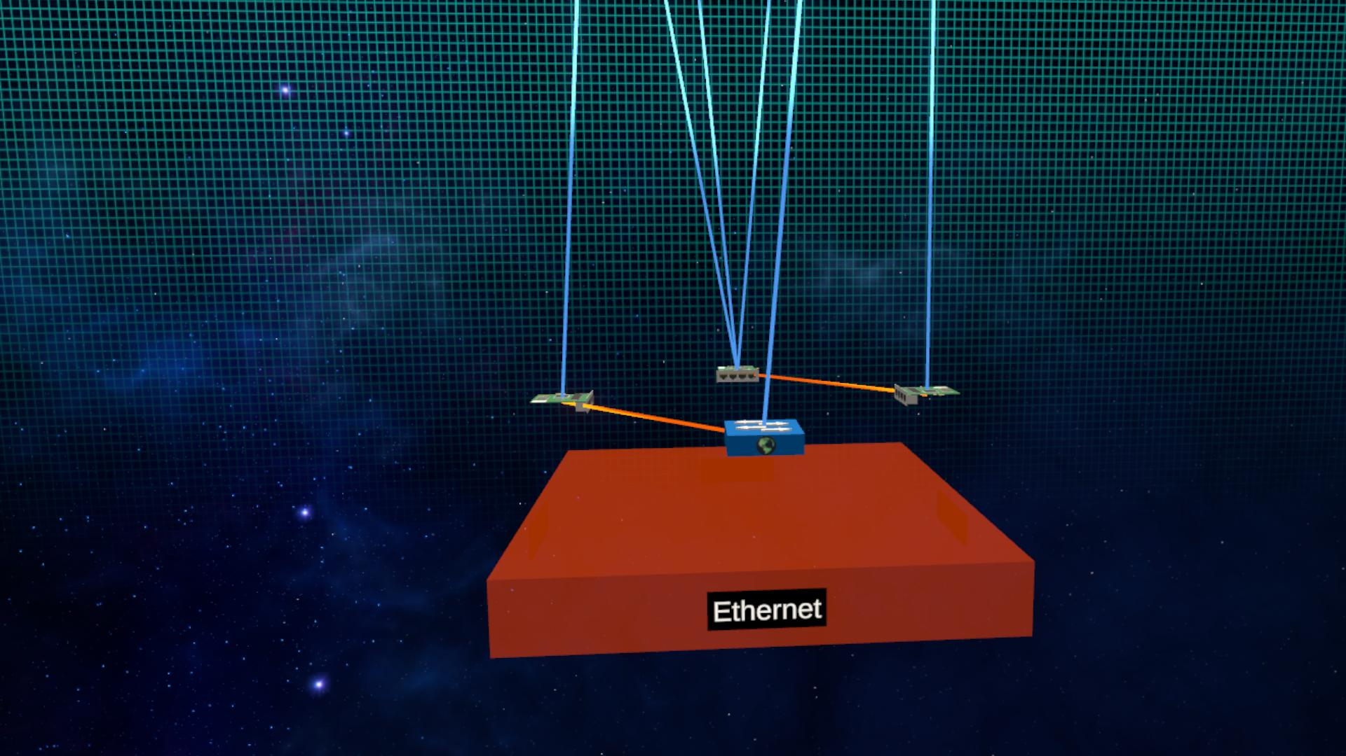
Elements
Device Link
Traffic Link
Nodes represent a network device at a particular protocol level.
Blue Device links connect a single device across protocol levels.
Orange Traffic links represent traffic flow between network devices.
Node
Protocol

Slide 7
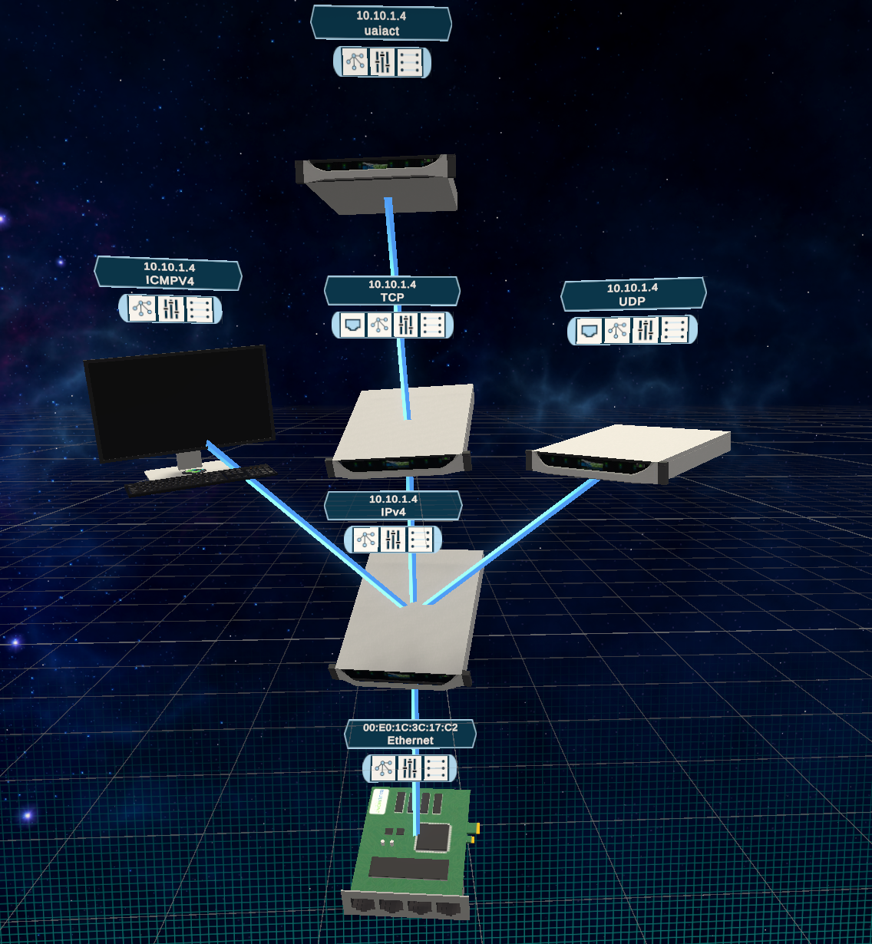
Device View
Here we see a single network device identified by MAC and IP address.
Each node represents a specific protocol the entity used during the capture.

Slide 8
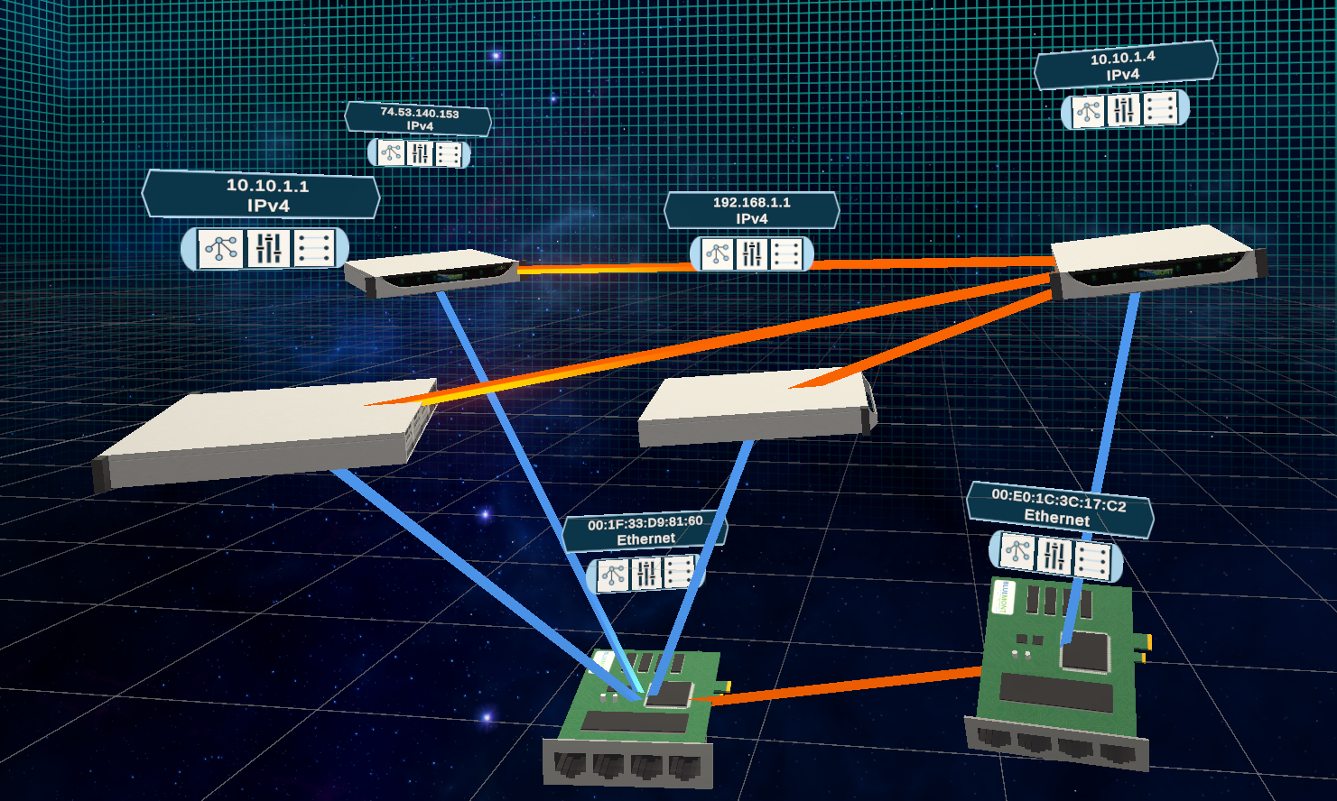
Interpreting The Network Diagram
The orange links indicate traffic between devices A and B.
Device A used 3 different IPv4 addresses during the capture.
B
A

Slide 9
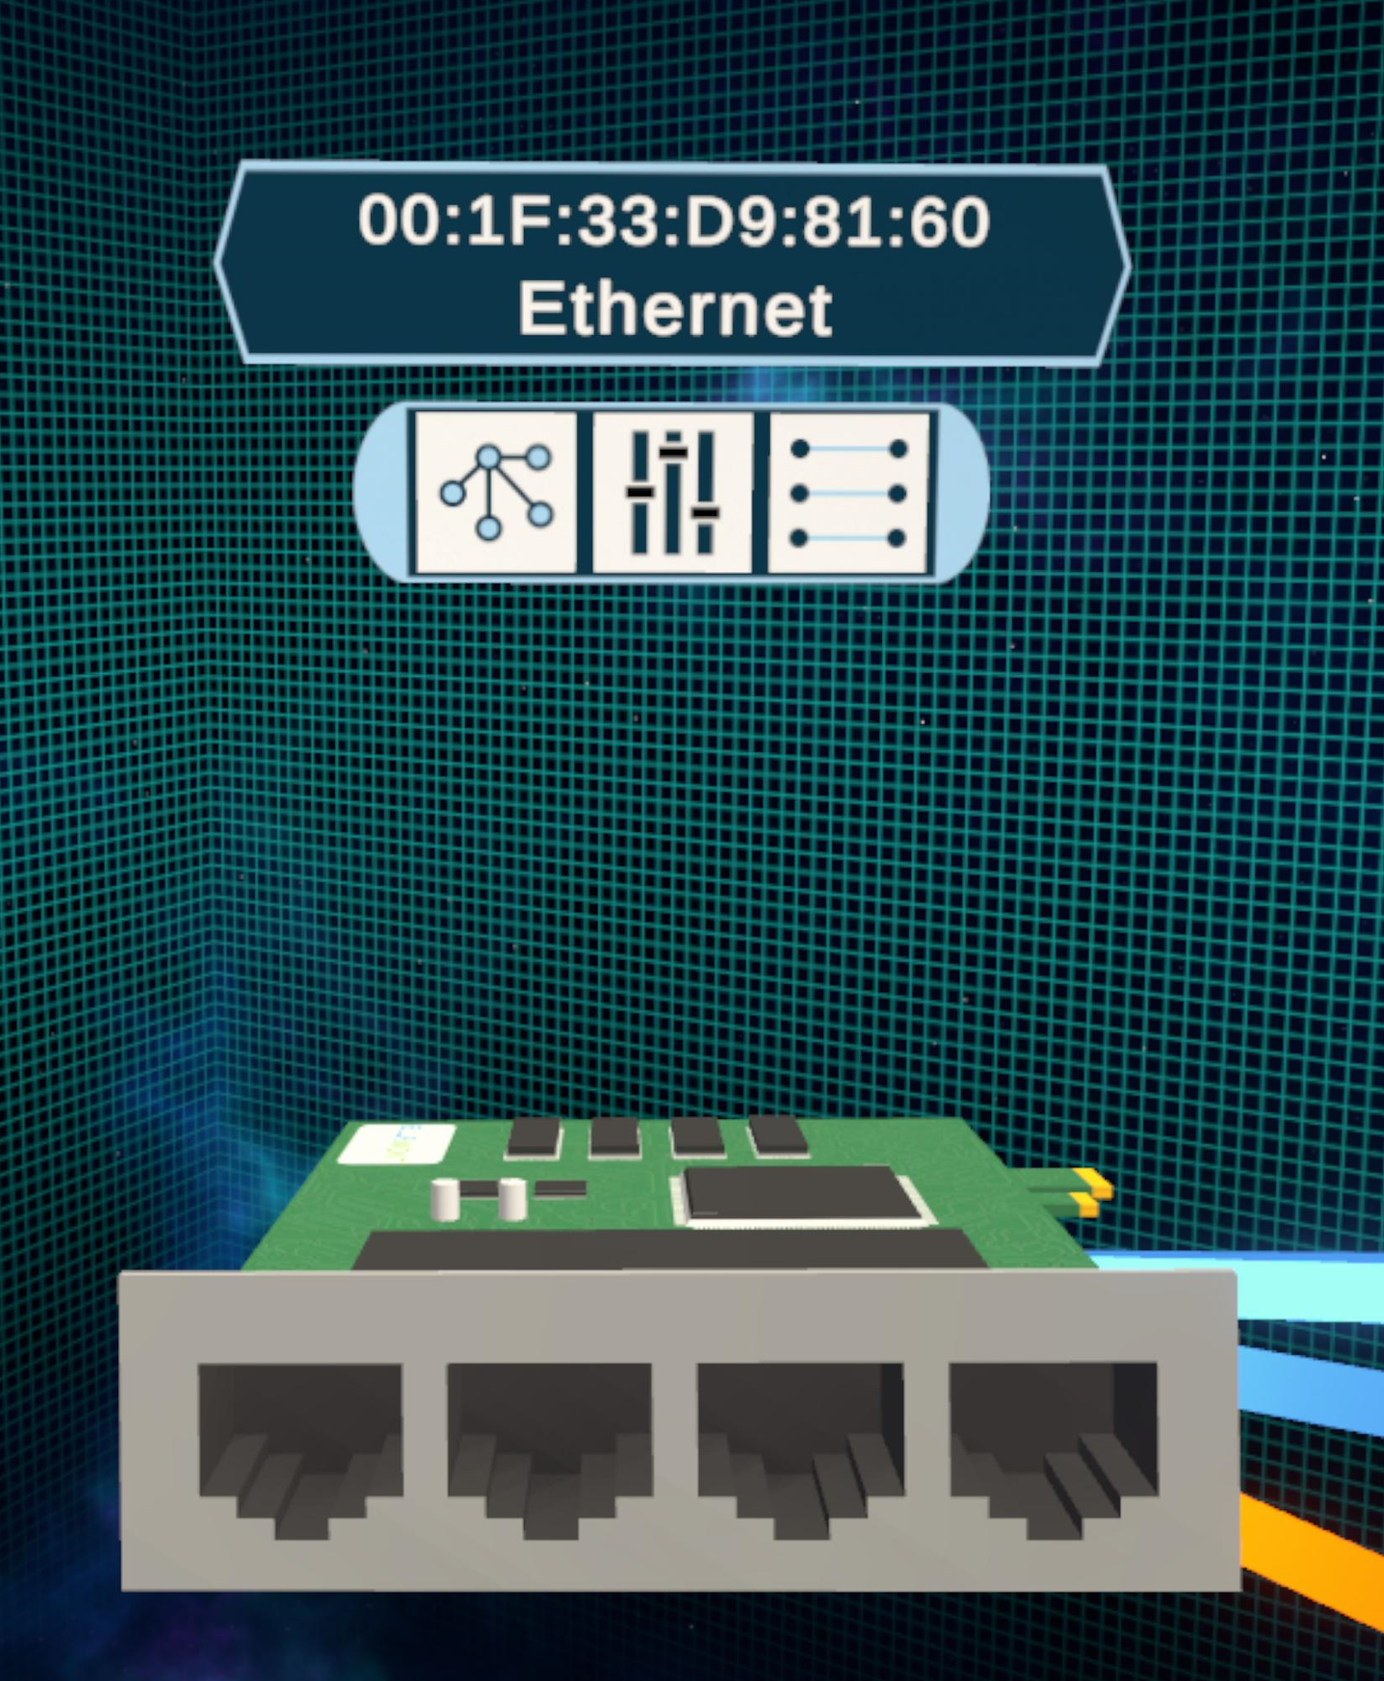
Node Buttons
1
2
3
Nearest Neighbor Filter
Node Packet Transfer Stats
Links List

Slide 10
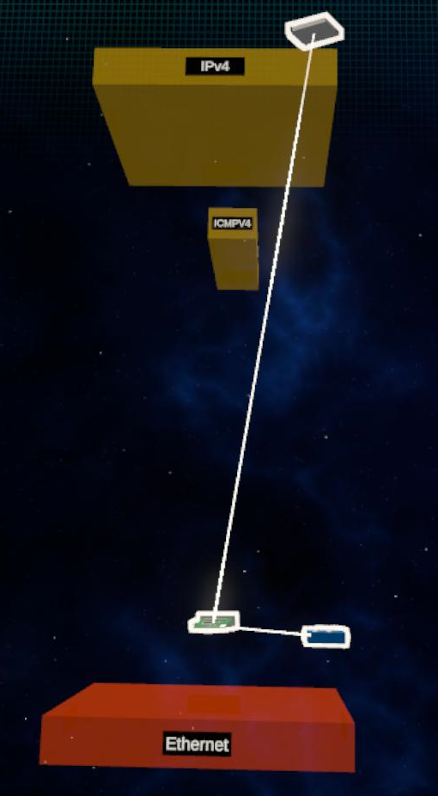
Nearest Neighbor
Nearest neighbor filter hides all nodes in the network except the target node’s nearest traffic and device links.

Slide 11
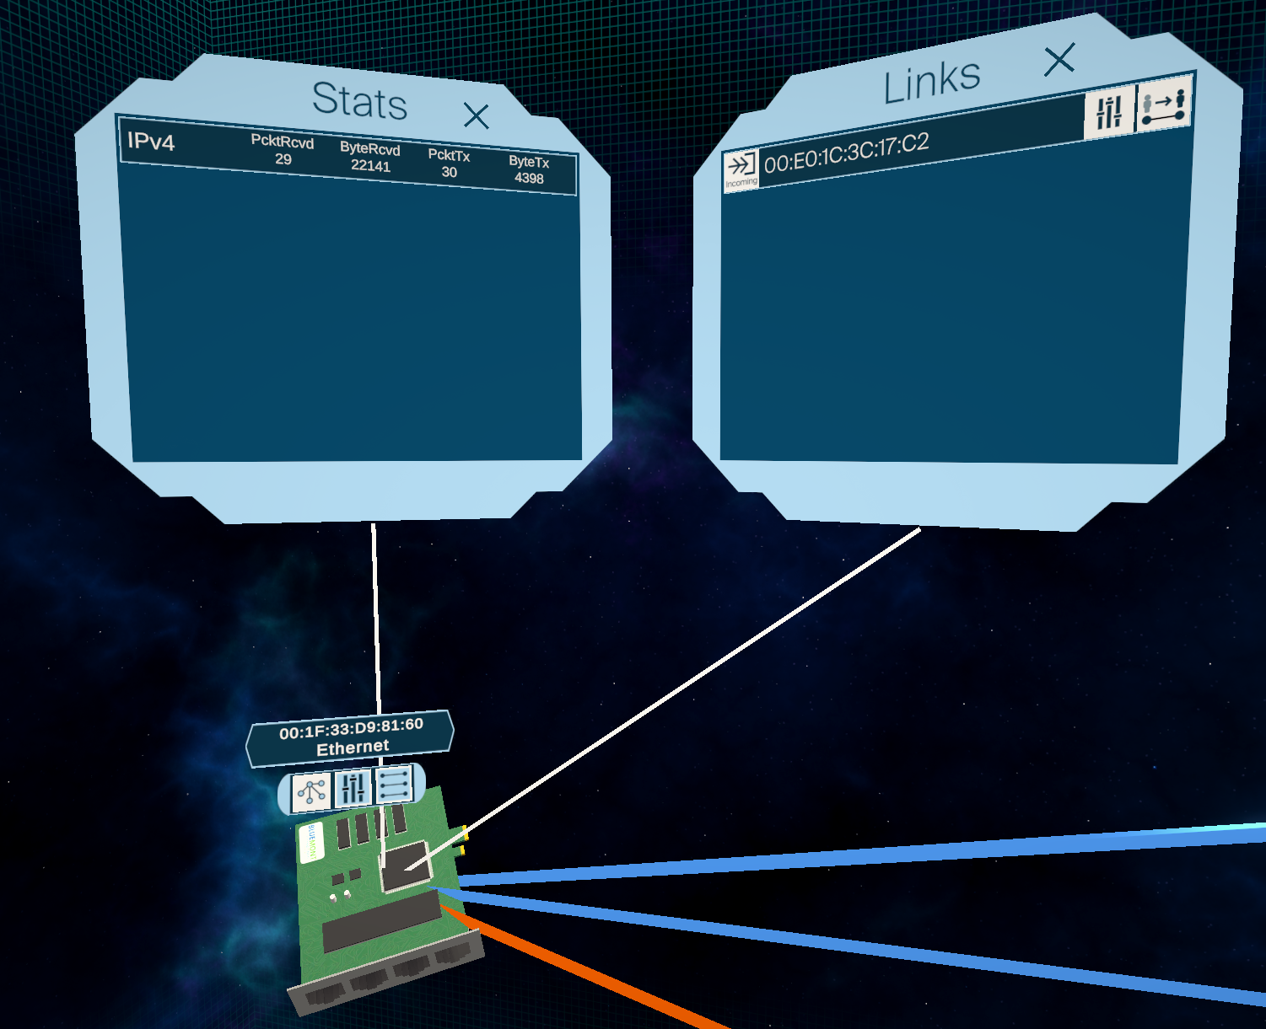
Node Stats & Links List
Node stats show info about packet transfer.
Links list shows all detected traffic links.

Slide 12
Version 1.0 - Additional Features
Peer to Peer Multiplayer Support With Voice Chat
3D Annotations (Draw Mode)
Network Model Filters (by Protocol & Link Type)

Slide 13
Version 1.5 – Planned Features
More Detailed Application Layer Deep Packet Analysis Using nDPI
In App Network Capture Support
Improved Network Layout Options

